Slide 1
Repeated measurements
Explaining variation using mixed models

Slide 2
Why take this option?

Slide 3
Outline
Repeated measurements, information and power -> design
Mixed models
Random effects and variance components
Bayesian estimation

Slide 4
Key theme: Variability
Effect on power/estimation/inference
As a phenomenon itself

Slide 5
Today
What is multilevel modelling?
Why might you want it?
What problems does it solve?
Starting to do it in R

Slide 6
What problem are we trying to solve?
Generate examples of repeated measures

Slide 7
Hidden causes

Slide 8
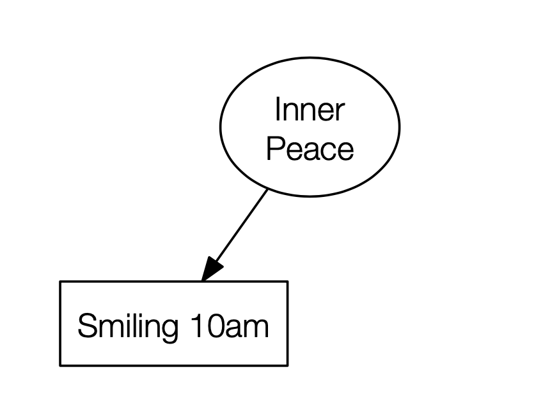

Slide 9
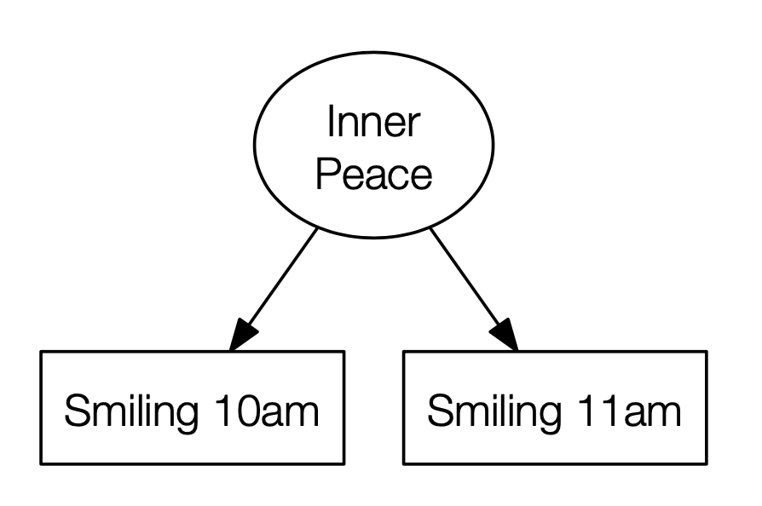

Slide 10
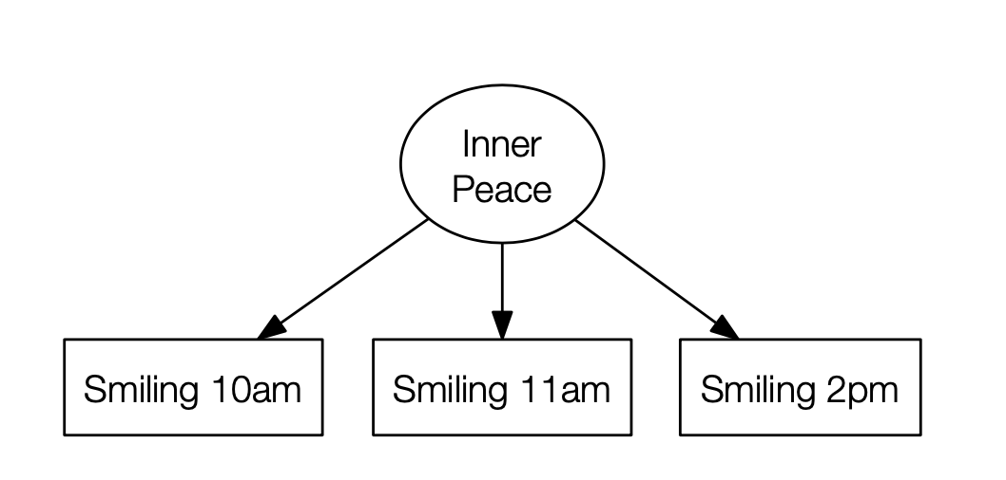

Slide 11
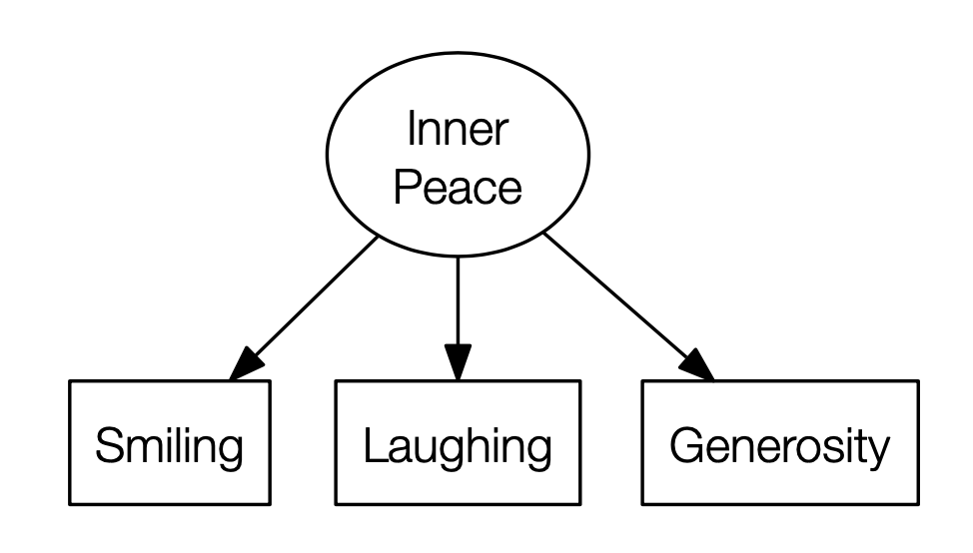

Slide 12
Social science datasets exhibit classification/nesting

Slide 19
All different forms of repeat measures…
Or, put another way of saying, sources of variation.

Slide 20
Schools exercise 1

Slide 21
Schools exercise 2

Slide 22
Recap on…
Mean, Variance, Std. Deviation, Residuals

Slide 23
Assumptions about residuals
Normally distributed (important for parametric NHST)
Independent, identically distributed (IID)
Homoscedasticity

Slide 24
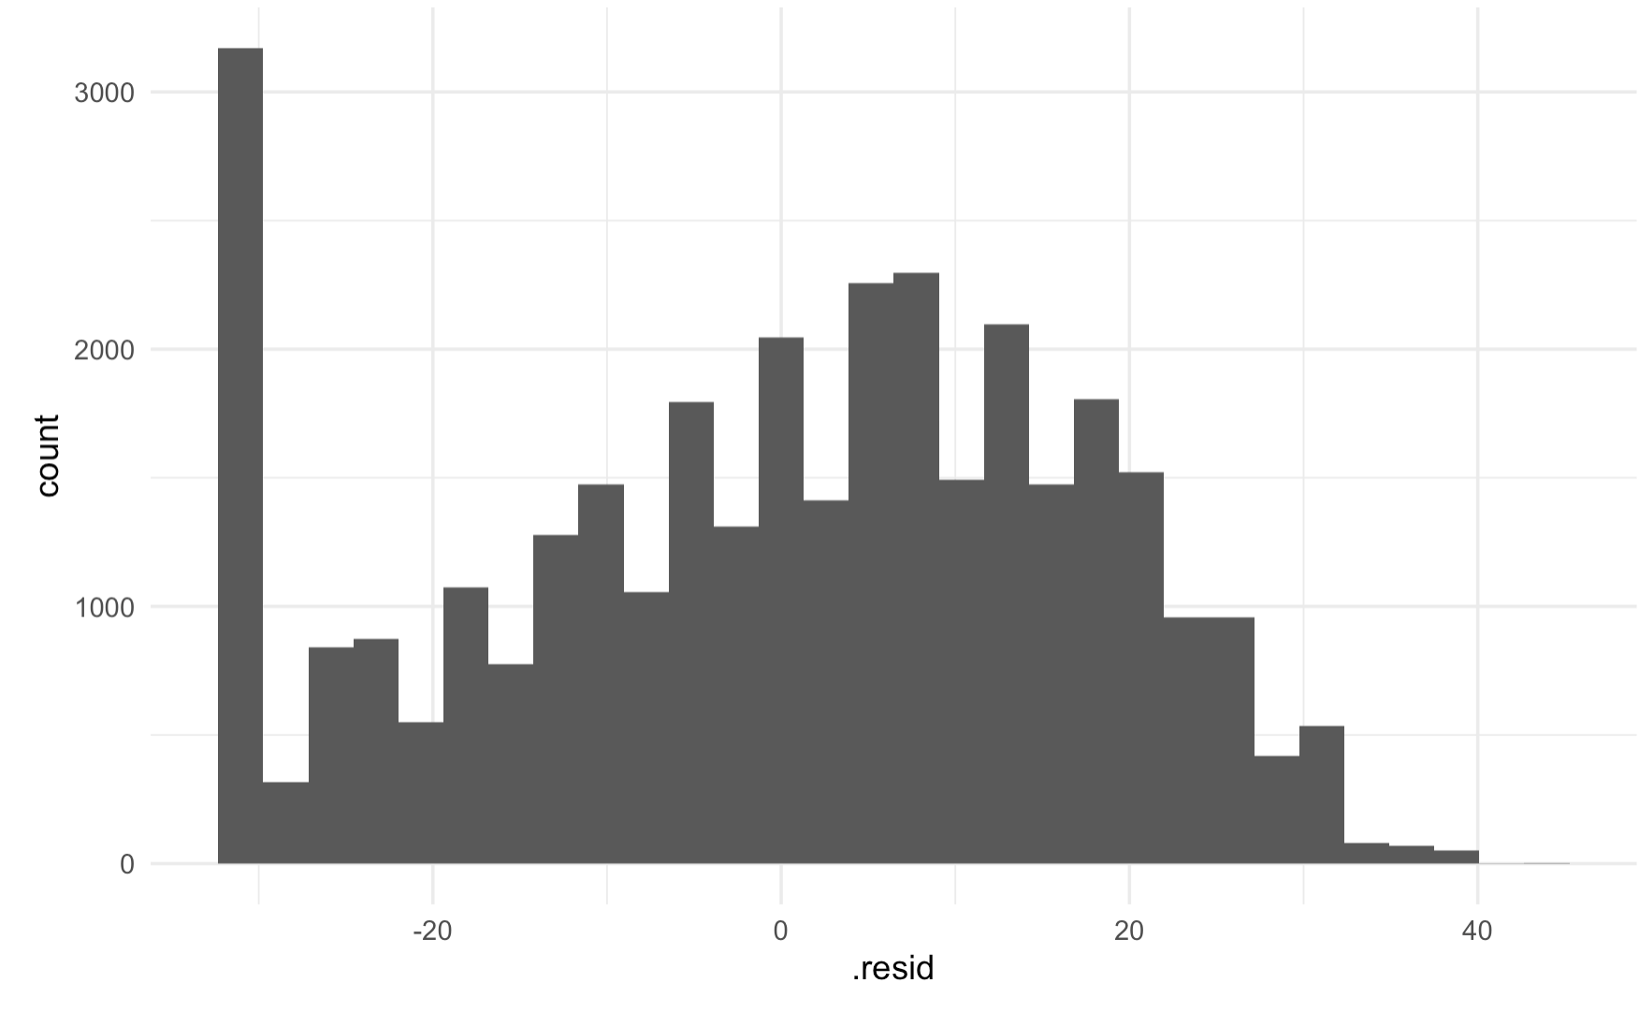

Slide 25
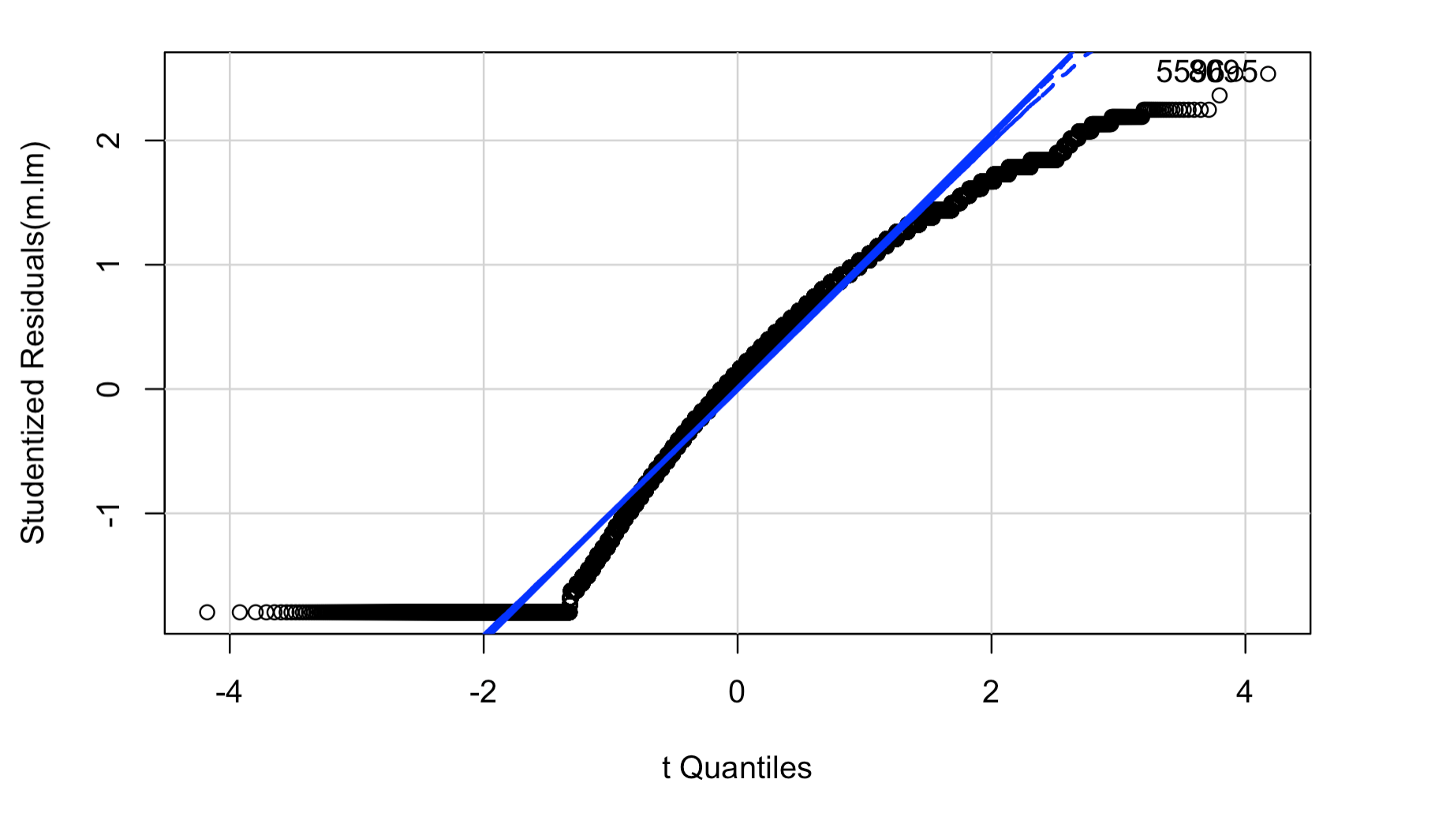

Slide 27
Violates IID assumption
= good way to get non-normal residuals

Slide 28
How does this all link to running linear models?
Imagine we have
Outcome = Y
Predictor = X
Repeated measurements of individuals

Slide 30
y ~ 1

Slide 36
Splitting the variance
Within-cluster
Between-cluster
Can term it a random intercepts model
Instead of a being nuisance, clustering in the variance can now be the thing of interest

Slide 37
Variance partition
total
between
within

Slide 38
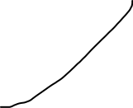
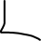
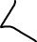
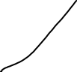
Schools
State/Private
Leadership
Teaching quality
SES
Gender
Genetics
Motivation
Student
Student
Student
Student

Slide 39
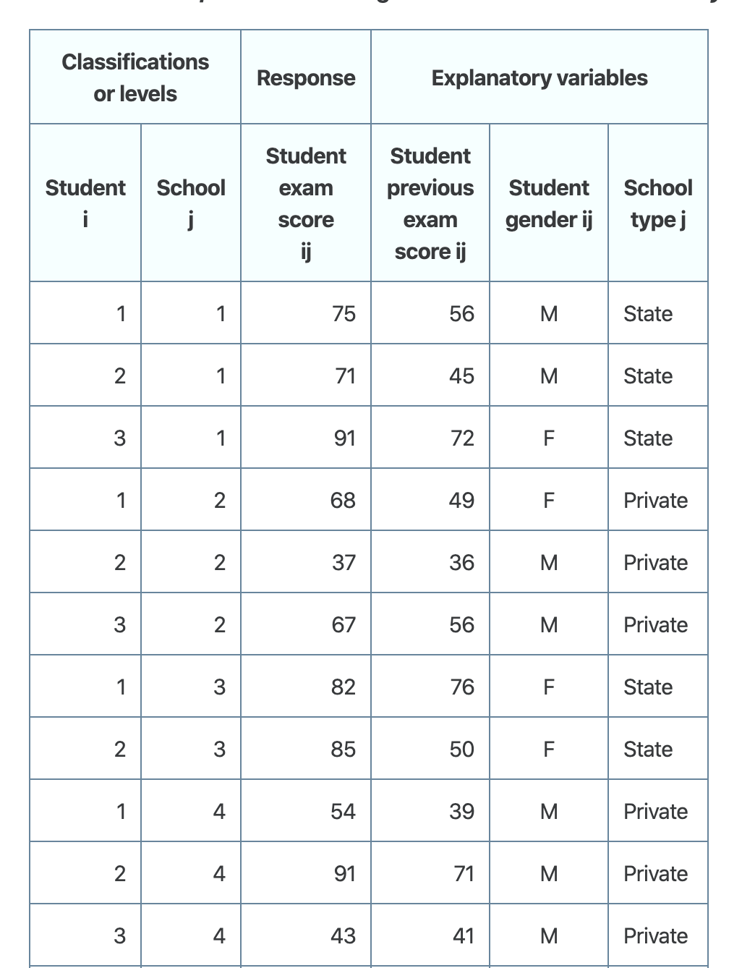

Slide 40
lm(score ~ schooltype)

Slide 42
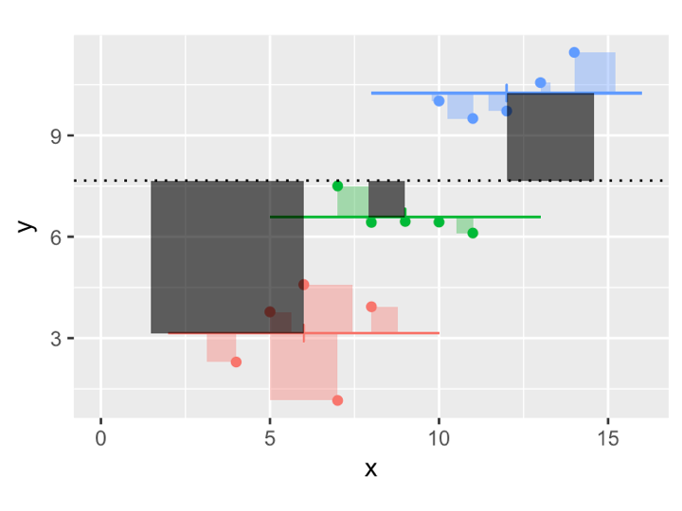




Mixed models split the error term
Standard multiple regression - i represents an individual
Mixed regression - i represents an individual, j represents a measurement

Slide 43
Mixed models
Flexible technique for splitting variance
Has superseded RM Anova except in simplest cases (balanced data, no missing, not interested in variability, no stimulus effects)
Already widely adopted in health and psycho-linguistics
Fitting with the `lmer` function, using `lmerTest` library.
Formulas now have a 'random part'

Slide 44
This is the 'fixed' part which is just like lm
This is the 'random' part of the model
library(lmerTest)
lmer(outcome ~ predictors + (1|grouping)
The 1 just means add an intercept
This is the grouping variable

Slide 45
lmer(score ~ 1 + (1|school) )

